Slide 1
Hotel Data Analysis and Visualization
To understand the business requirement and provide data driven insights.

Slide 2
Requirements
Build a visual data story or dashboard using PowerBI to present to your stakeholders.
“Is our hotel revenue growing by year?”
“Should we increase our parking lot space?”
“What trends can we see in the data?”
Focus on average daily rate and guests to explore seasonality.
We have two hotel types so it would be good to segment revenue by hotel type.
We want to understand if there is a trend in guests with personal cars.

Slide 3
Data Analysis project pipeline
1
2
3
4
5
Build a database
Develop the SQL
Query
Visualize
Connect PowerBI to the Database
Summarize Findings

Slide 4
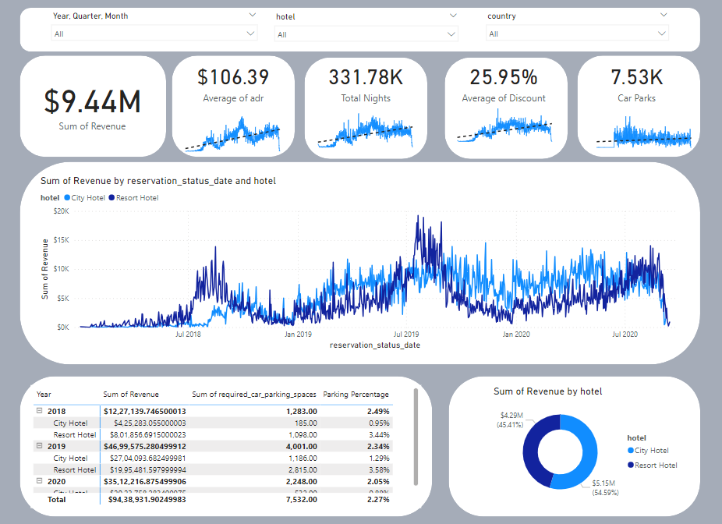

Slide 5
Insights
Is our hotel revenue growing by year?
“Should we increase our parking lot space?”
“What trends can we see in the data?”
"Over the years, our hotel revenue has exhibited a consistent upward trajectory across both categories, reflecting sustained growth and positive market response to our offerings."
"The current data indicates a flat trend, suggesting no compelling evidence for an immediate need to increase parking lot space. “
“The revenue per category , ADR(Average Daily Rate), Total Nights and Discounts show an increasing trend while the car parks show a flat trend.

Slide 6
THANK YOU

